Slide 1
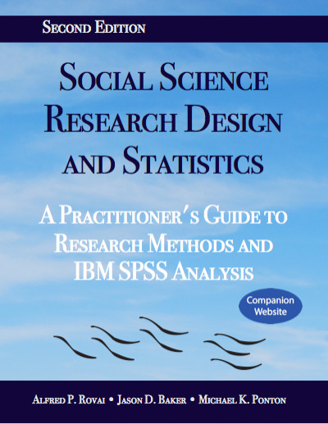
Social Science Research Design and Statistics, 2/e
Alfred P. Rovai, Jason D. Baker, and Michael K. Ponton
Bivariate Linear Regression
PowerPoint Prepared by
Michael K. Ponton
IBM® SPSS® Screen Prints Courtesy of International Business Machines Corporation,
© International Business Machines Corporation.

Slide 2
Uses of the Bivariate Linear Regression
Predict the value of a single dependent (or criterion) variable using values of a single independent (or predictor) variable.
Test the hypothesis that there is no correlation between the actual and predicted DV values in the population; that is, the IV does not statistically predict the DV.

Slide 3
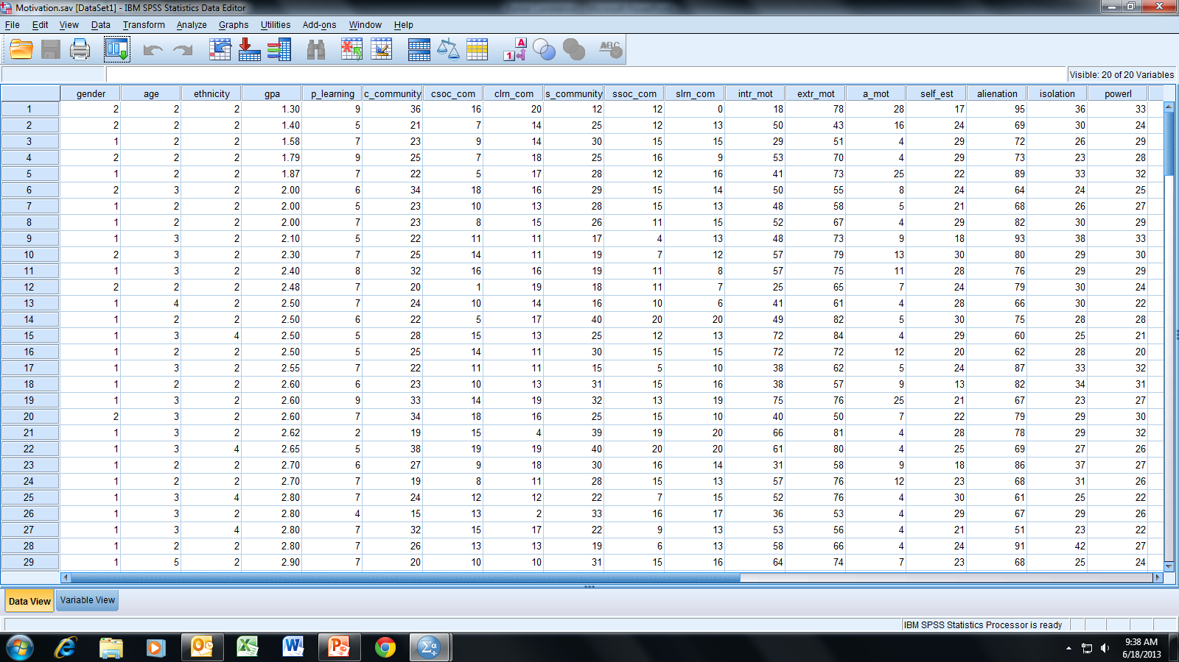
Open the dataset Motivation.sav.
File available at http://www.watertreepress.com/stats

Slide 4
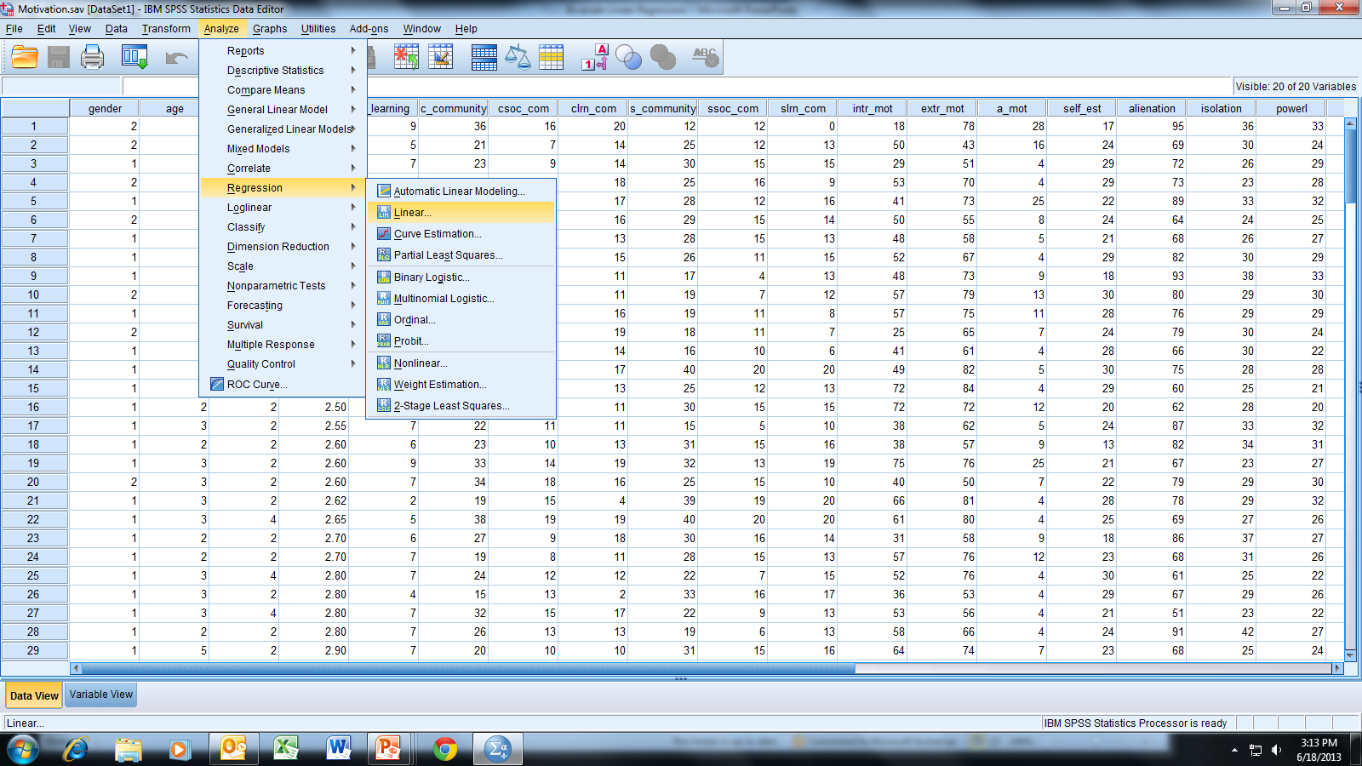
Follow the menu as indicated.

Slide 5
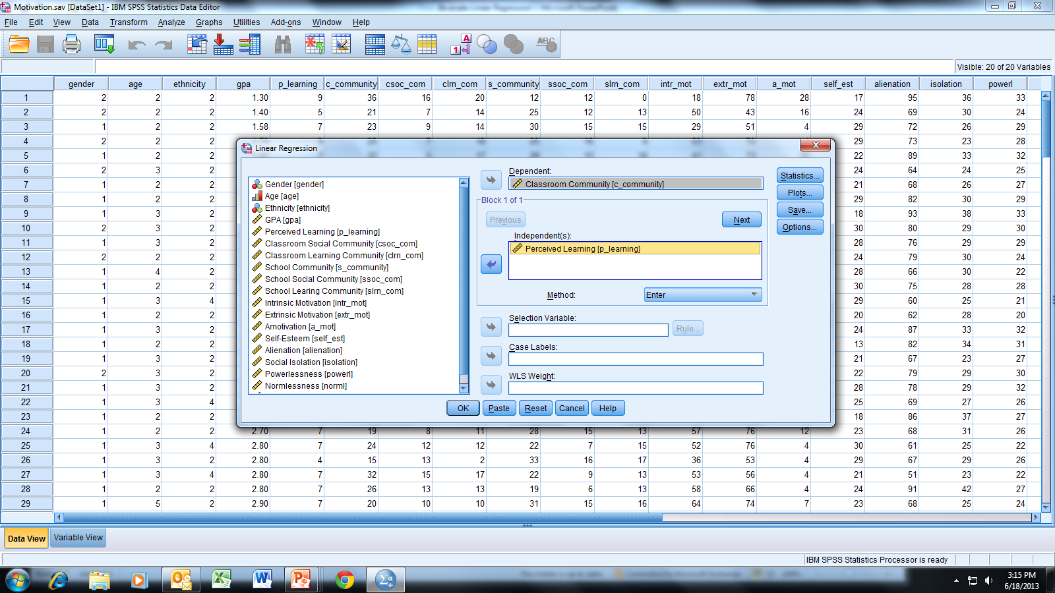
Select and move Classroom Community [c_community] and
Perceived Learning [p_learning] to the Dependent and Independent
variable boxes, respectively; click OK.

Slide 6
How well does the linear regression equation model the relationship between the DV and IV?
We must define R to answer this question. R = Pearson product-moment correlation between DV(raw data) and DV(predicted)*. That is, for every value of the IV in the raw data, we can calculate a predicted value for the DV using the
regression equation. The correlation between these predictions and the raw data associated with the DV is R. If the equation is a very good prediction model for the DV, then R should be very close to 1 (R will always range from 0 to 1) because DV(predicted) will be very similar to DV(raw data) for each value of the IV(raw data).
*Note: For bivariate linear regression, R = |r_{DV,IV}|.

Slide 7
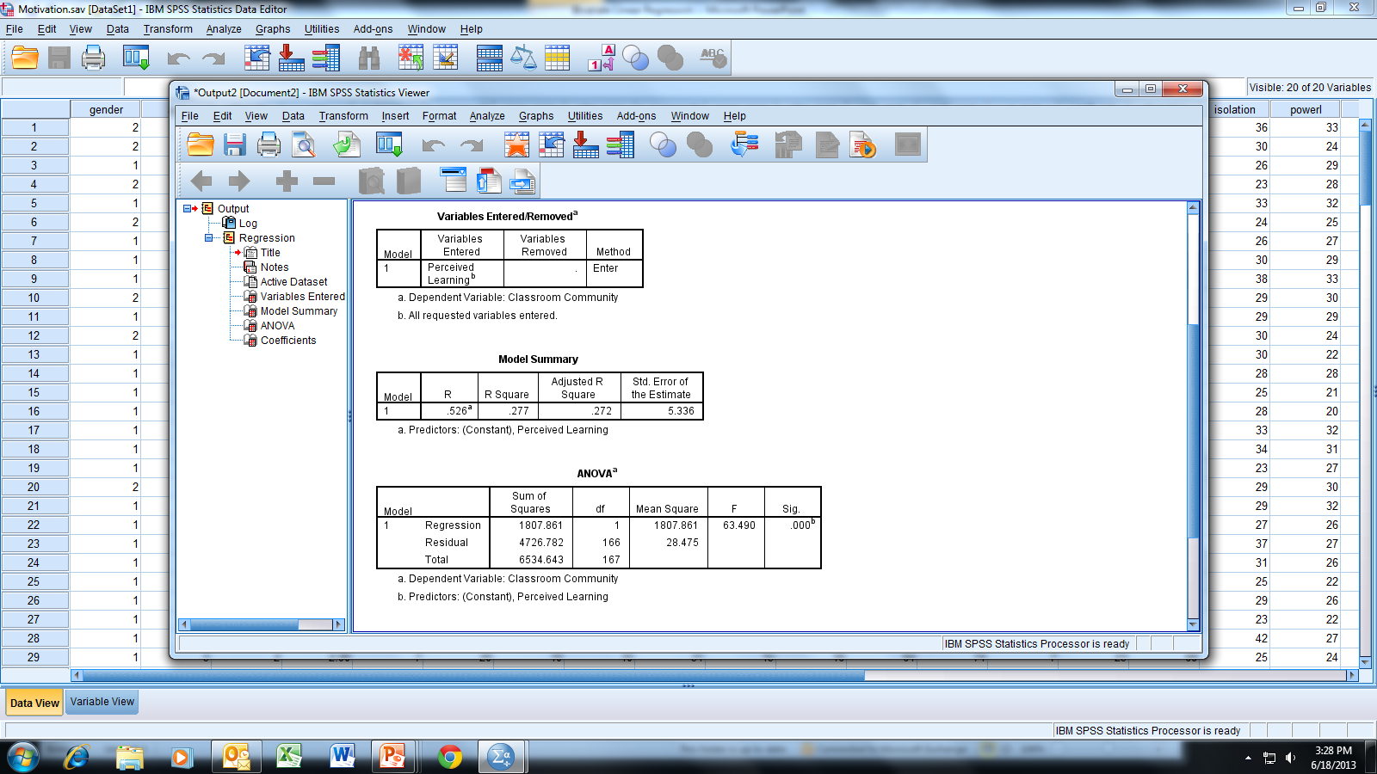
To test the statistical significance of the regression equation, we check the
significance associated with the ANOVA table from the linear regression output.
The null hypothesis is H_{o}: R_{pop} = 0.
(R_{pop} represents the population parameter for R; R is the sample statistic.)
Choose α (for this example, choose α = .05).
In this example, Sig. < .001, which is less than .05; therefore, we reject H_{o}.
We conclude that our linear regression equation is statistically significant.

Slide 8
To determine practical significance, we look at the value for R.
Similar to correlation (i.e., r), we can qualitatively interpret
R as being moderate; cf. Hinkle, D. E., Wiersma, W., & Jurs, S. G.
(1998). Applied statistics for the behavioral sciences (4th ed.).
Boston, MA: Houghton Mifflin. p. 120.

Slide 9
R² indicates that 27.7% of the variance in the DV (classroom community)
is associated with the IV (perceived learning).

Slide 10
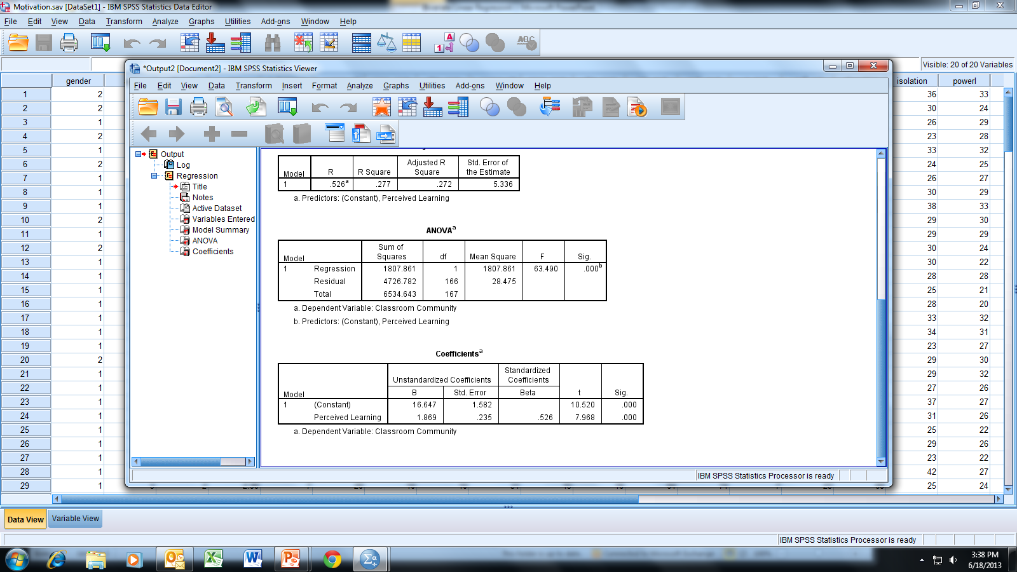
Scroll down to the bottom portion of the output.
R² indicates that 27.7% of the variance in the DV (classroom community)
is associated with the IV (perceived learning).

Slide 11
We use the “Unstandardized Coefficients” to develop a linear
regression equation for prediction. Unstandardized indicates that
the coefficients are for an equation in units of the raw data
(i.e., data as actually recorded and not converted to z-scores).
R² indicates that 27.7% of the variance in the DV (classroom community)
is associated with the IV (perceived learning).

Slide 12
The (rounded) unstandardized coefficients are used to produce the
following prediction equation:
DV’ = 1.87 * IV + 16.65
where DV’ = classroom community (predicted) and IV = perceived learning.
Thus, for a given IV value, we can use this equation to predict a DV value.
R² indicates that 27.7% of the variance in the DV (classroom community)
is associated with the IV (perceived learning).

Slide 13
The “Standardized [Beta] Coefficients” are used to develop a standardized
regression equation that is written in terms of z-scores. The “Sig.” value is
used to test the null hypothesis β = 0 for the IV indicated in the row. Note
that β for perceived learning is statistically nonzero (Sig. < .001).
β = .526 in the standardized regression equation for this example indicates
that the predicted value for classroom community increases 1 standard
deviation unit for an increase of .526 standard deviation units in
perceived learning.
R² indicates that 27.7% of the variance in the DV (classroom community)
is associated with the IV (perceived learning).

Slide 14
End of Presentation

